Slide 1

aspiring minds university
Introduction to Statistical Learning
Module 1
Data Visualization

Slide 2
Why data visualization?
The human brain is very good at recognizing patterns.
Presenting the information visually using many channels allows the brain to intuitively understand data.
There are several pitfalls to relying purely on statistical measures

Slide 3
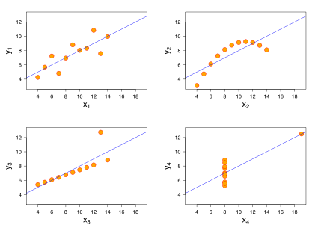
Anscombe’s Quartet
Anscombe’s Quartet – 4 series of data that have the same summary statistics but are very different
Image source: Wikimedia Commons

Slide 4
Exercise 1a : Graph Anscombe’s Quartet!
Download Anscombe.csv
Calculate the following for each pair of x’s and y’s:
Mean of x’s
Mean of y’s
Standard deviation of y’s
Fit a line and compare coefficients
Find some way of seeing absolute errors
Graph scatter plots for y vs x.
What about the advanced numerical methods we’ll learn in this course?
[re-phrase to make simpler]
Many statistical measures, tests and methods are based on assumptions about data.
Data visualization can help to ensure that these assumptions are correct!

